Slide 2
Q
A
“Is livestream worship the same as going to church?”

Slide 3

Other Q’s in the ballpark
What about when you’re on vacation sans church?
What about if there are 2-3 gathered?
Can you LS by yourself?
What are you supposed to do when you’re sick or miss?
What I’m not dealing with.

Slide 4
What it means to come together
“since you come together not for the better but for the worse.” (11:17)
“when you come together as a church...” (v.18)
“when you come together in one place...” (v.20)
“Therefore, my brethren, when you come together to eat, wait for one another. But if anyone is hungry, let him eat at home, lest you come together for judgment.” (11:33-34)

Slide 5
What it means to come together
“Therefore, if the whole church comes together in one place...” (14:23)
“How is it then, brethren? Whenever you come together...” (14:26)
Same time
Same place
_______________+
Come Together

Slide 6
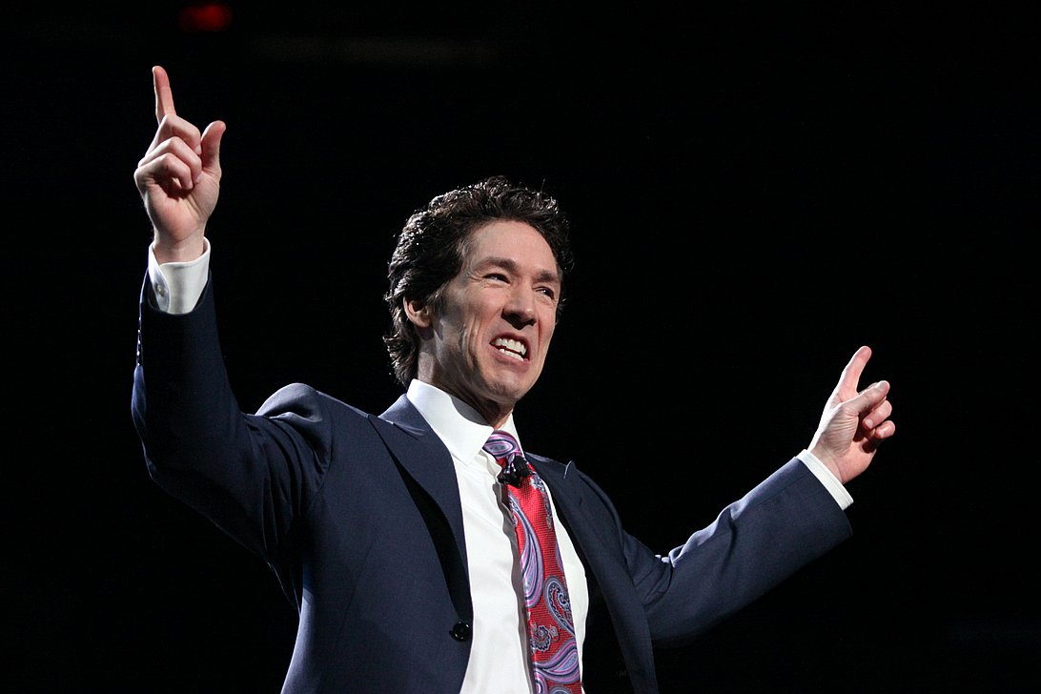
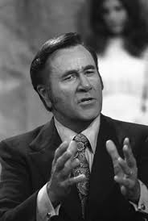
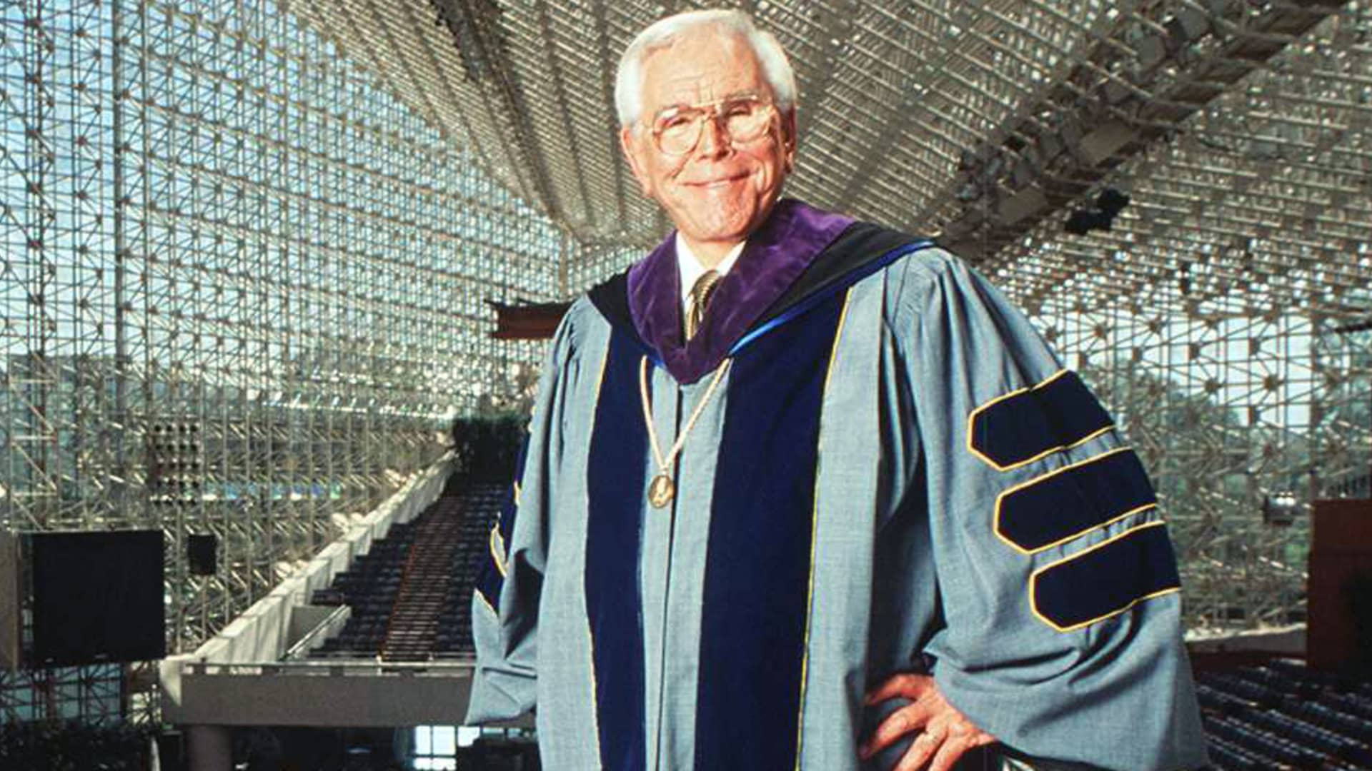
Worshipping with them?

Slide 7
Coming Together
In the OT: Deut. 16:1-8
The ultimate together: Rev. 21:3

Slide 8
The Pattern
Outside/Inside Assembly - sing, pray, teach, and preach
Assembly only:
  Lord’s Supper. 1 Cor. 10:16-17, 1 Cor. 11
  The Collection. 1 Cor. 16:1-2
  Individually

Slide 9
Arguments for
In the negative: what about Paul?
Silence and “better than nothing”
2-3 are gathered? - Matt. 18:20

Slide 10
Bottom Line
Checklist God
An understanding God (Numb. 9:1-14)
  OT precedent
  Prevented
  Suffering
  But willfully?
Answer? No.

Slide 11
What you’ll miss
Real Reality
Real Relationships
Real Stirring Up
Come together and worship with the saints every opportunity you can.

